Slide 1
Lecture 39
UNSUPERVISED LEARNING NETWORKS

Slide 2
INTRODUCTION
Competition
Winner take all
Unsupervised – neural net seeks to find patterns or regularity in the input data
Clustering nets –
no. of input units = no. of components in input vector
No. of output units = no. of clusters
Weight vector for an output serves as exemplar for input patterns placed in the cluster
During training, the net determines the output unit that is the best match for the current input vector and the weight vector for the winner is adjusted according the learning algorithm.
W(new) = w(old) + α[x – w(old)]
Determining the closest weight vector to a pattern vector

Slide 3
INTRODUCTION
Determining the closest weight vector to a pattern vector
Euclidean distance – between weight vector and input vector
Dot product – of weight vector and input vector

Slide 4
UNSUPERVISED LEARNING
No help from the outside.
No training data, no information available on the desired output.
Learning by doing.
Used to pick out structure in the input:
Clustering,
Reduction of dimensionality → compression.
Example: Kohonen’s Learning Law.

Slide 5
FEW UNSUPERVISED LEARNING NETWORKS
There exists several networks under this category, such as
Max Net,
Mexican Hat,
Hamming Network,
Kohonen Self-organizing Feature Maps,
Adaptive Resonance Theory.
Learning Vector Quantization,
Counterpropagation Networks,

Slide 6
COMPETITIVE LEARNING
Output units compete, so that eventually only one neuron (the one with the most input) is active in response to each output pattern.
The total weight from the input layer to each output neuron is limited. If some connections are strengthened, others must be weakened.
A consequence is that the winner is the output neuron whose weights best match the activation pattern.

Slide 7
SELF-ORGANIZATION
Network Organization is fundamental to the brain
Functional structure.
Layered structure.
Both parallel processing and serial processing require organization of the brain.

Slide 8
SELF-ORGANIZING FEATURE MAP
Our brain is dominated by the cerebral cortex, a very complex structure of billions of neurons and hundreds of billions of synapses. The cortex includes areas that are responsible for different human activities (motor, visual, auditory, etc.) and associated with different sensory inputs. One can say that each sensory input is mapped into a corresponding area of the cerebral cortex. The cortex is a self-organizing computational map in the human brain.

Slide 9
SELF-ORGANIZING NETWORKS
Discover significant patterns or features in the input data.
Discovery is done without a teacher.
Synaptic weights are changed according to local rules.
The changes affect a neuron’s immediate environment until a final configuration develops.

Slide 10
KOHONEN SELF-ORGANIZING FEATURE MAP (KSOFM)
Feature mapping : Converts the patterns of arbitrary dimensionality into a response of 1-D or 2-D arrays of neurons.
Networks performing such mapping is called feature map.
Capability to preserve the neighborhood relations of the input patterns i.e. topology preserving
M – output cluster units arranged in 1-D or 2-D array
Input signals are N – tuples
Weight vectors of cluster units serve as an exemplar vector
Self-organization:
the weight vector of the cluster unit which matches the input pattern very closely is chosen the winner unit.
Weights are updated for winning unit and neighboring units.

Slide 11
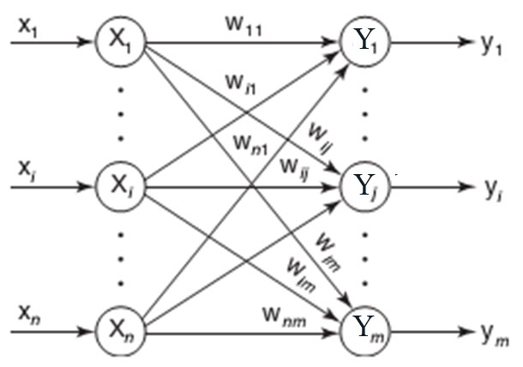
ARCHITECTURE OF KSOFM

Slide 12
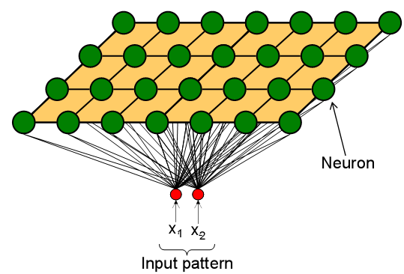
COMPETITION OF KSOFM
Each neuron in an SOM is assigned a weight vector with the same dimensionality N as the input space.
Any given input pattern is compared to the weight vector of each neuron and the closest neuron is declared the winner.
The Euclidean norm is commonly used to measure distance.

Slide 13
CO-OPERATION OF KSOFM
The activation of the winning neuron is spread to neurons in its immediate neighborhood.
This allows topologically close neurons to become sensitive to similar patterns.
The winner’s neighborhood is determined on the lattice topology.
Distance in the lattice is a function of the number of lateral connections to the winner.
The size of the neighborhood is initially large, but shrinks over time.
An initially large neighborhood promotes a topology-preserving mapping.
Smaller neighborhoods allow neurons to specialize in the latter stages of training.

Slide 14
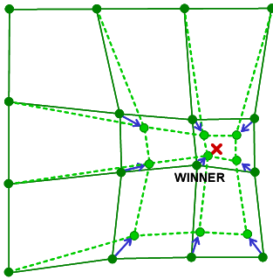
ADAPTATION OF KSOFM
During training, the winner neuron and its topological neighbors are adapted to make their weight vectors more similar to the input pattern that caused the activation.
Neurons that are closer to the winner will adapt more heavily than neurons that are further away.
The magnitude of the adaptation is controlled with a learning rate, which decays over time to ensure convergence of the SOM.

Slide 15
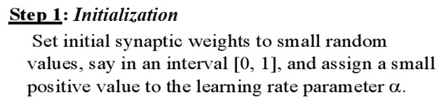
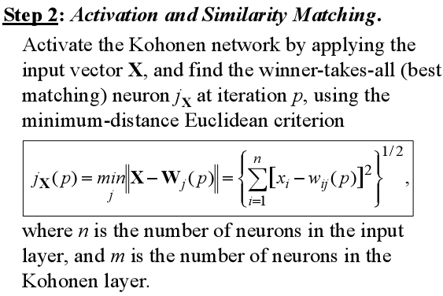
KSOFM ALGORITHM

Slide 16
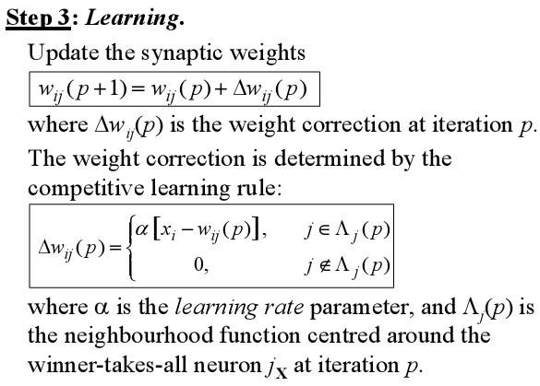
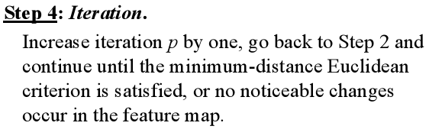

Slide 17
Construct a KSOFM net with two cluster units and four input units. [0 0 1 1], [1 0 0 0], [0 1 1 0], [0 0 0 1]. Assume initial learning rate of 0.5
The weight vectors for the cluster units are given by
w1 = [0.2 0.4 0.6 0.8]
w2 = [0.9 0.7 0.5 0.3]

Slide 18
Algorithm
The radius of the neighborhood around a cluster unit also decreases as the clustering process progresses.
The formation of a map occurs in two phases: the initial formation of the correct order and the final convergence.
The second phase takes much longer than the first and requires a small value for the learning rate.
Many iterations through the training set may be necessary, at least in some applications.

Slide 19

Example 4.4
A Kohonen self-organizing map (SOM) to cluster four vectors.
Let the vectors to be clustered be:
The maximum number of clusters to be formed is
Suppose the learning rate (geometric decrease) is:

Slide 20
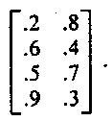

Example 4.4
With only two clusters available, the neighborhood of node J (Step 4) is set so that only one cluster updates its weights at each step (i.e., R = 0).
Step 0. Initial weight matrix:
Initial radius: R=0.
Initial learning rate:
Step 1. Begin training.
Step 2. For the first vector, (1, 1, 0, 0), do Steps 3-5.

Slide 21
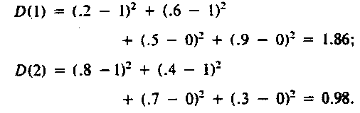

Example 4.4
Step 3.
Step 4. The input vector is closest to output node 2, so J = 2.
Step 5. The weights on the winning unit are updated:

Slide 22
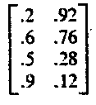
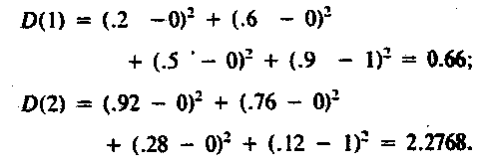
Example 4.4
This gives the weight matrix
Step 2. For the second vector, (0, 0 , 0 , 1 ) , do Steps 3-5.
Step 3.

Slide 23
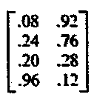
Example 4.4
Step 4. The input vector is closest to output node 1 , so
J=1.
Step 5. Update the first column of the weight matrix:

Slide 24
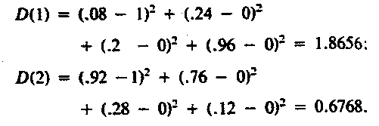
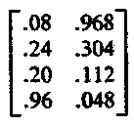
Example 4.4
Step 2. For the third vector, ( 1 , 0, 0, 0), do Steps 3-5.
Step 3.
Step 4. The input vector is closest to output node 2, so
J = 2.

Slide 25
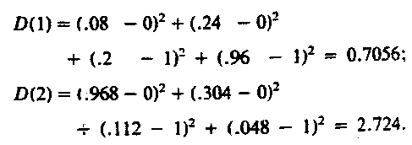
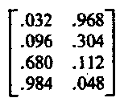
Example 4.4
Step 2. For the fourth vector, ( 0 , 0, 1, 1), do Steps 3-5.
Step 3.
Step 4. The input vector is closest to output node 1, so
J = 1.

Slide 26

Example 4.4
Step 6. Reduce the learning rate:
The weight update equations are now:
Modifying the adjustment procedure for the learning rate so that it decreases geometrically from .6 to .01 over 100 iterations (epochs) gives the following results:

Slide 27
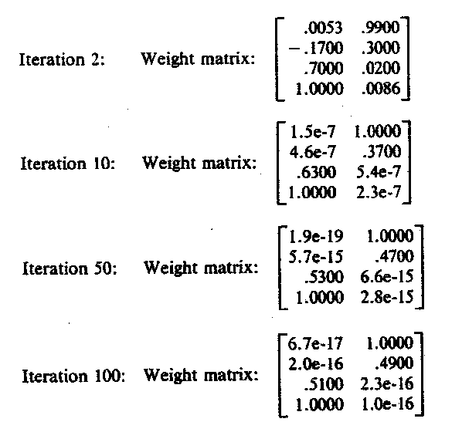
Example 4.4

Slide 28
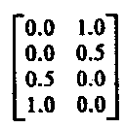
Example 4.4
These weight matrices appear to be converging to the matrix
the first column of which is the average of the two vectors placed in cluster 1 and the second column of which is the average of the two vectors placed in cluster 2.

Slide 29
ADAPTIVE RESONANCE THEORY (ART) NETWORK
Adaptive Resonance Theory (ART) is a family of algorithms for unsupervised learning developed by Carpenter and Grossberg.
ART is similar to many iterative clustering algorithms where each pattern is processed by
finding the "nearest" cluster (a.k.a. prototype or template) to that exemplar (desired).
updating that cluster to be "closer" to the exemplar.

Slide 30
ADAPTIVE RESONANCE THEORY (ART) NETWORK
Allow user to control the degree of similarity of pattern place on the same cluster.
The relative similarity of input pattern with the weight vector is used rather than the absolute difference.
Stability: a pattern does not oscillate among clusters.
Plasticity: respond to a new pattern equally well at any stage of learning.

Slide 31
Architecture
3 groups of neurons:
An input processing field (F1 layer).
Cluster unit (F2 layer).
A mechanism to control degree of similarity of patterns placed on the same cluster.
F1 layer consists of
Input portion F1(a)
Interface portion F1(b) : combines the signals from input portion & F2 layer to compare the similarity of the input signal to the weight vector of the selected cluster unit
F2 node is in one of the three states:
Active (“on”, activation = d; d = 1 for ART1)
Inactive (“off”, activation=0; but available to participate)
Inhibited (“off”, activation = 0 & prevented for participate)
Control of similarity: two sets of connections between each unit in the interface portion and cluster unit.
Bottom-up weights b_{ij} from ith F1 unit to jth F2 unit
Top-down weights t_{ji} from jth F2 unit to ith F1 unit

Slide 32
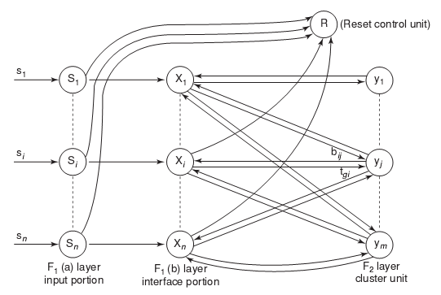
BASIC ARCHITECTURE OF ART1
“Principles of Soft Computing, 2nd Edition”
by S.N. Sivanandam & SN Deepa
Copyright © 2011 Wiley India Pvt. Ltd. All rights reserved.

Slide 33
Operation
the F2 layer is competitive layer.
Cluster unit with largest net input becomes the candidate to learn the input pattern.
activations of all other F2 units are set to zero.
interface units combine the information from input & cluster units
whether or not the cluster unit is allowed to learn the input patterns depends on how similar its weight vector is to the input vector and is decided by reset unit.
if a cluster is not allowed to learn it is inhibited and a new cluster unit is selected as the candidate.
degree of similarity is controlled by user defined vigilance parameter
a pattern once presented continues to send its input signal until learning trial is completed.

Slide 34
ARCHITECTURES OF ART NETWORK
ART1, designed for binary features.
ART2, designed for continuous (analog) features.
ARTMAP, a supervised version of ART.
“Principles of Soft Computing, 2nd Edition”
by S.N. Sivanandam & SN Deepa
Copyright © 2011 Wiley India Pvt. Ltd. All rights reserved.

Slide 35
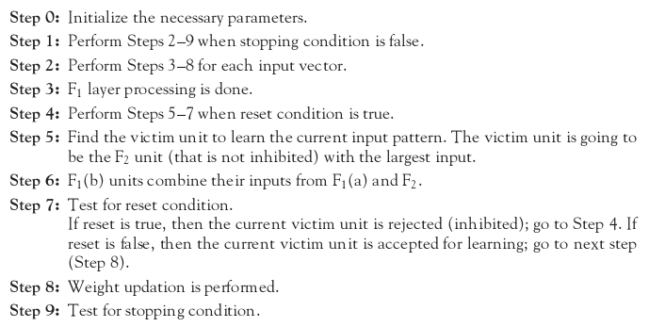
FUNDAMENTAL ALGORITHM OF ART NETWORK
“Principles of Soft Computing, 2nd Edition”
by S.N. Sivanandam & SN Deepa
Copyright © 2011 Wiley India Pvt. Ltd. All rights reserved.

Slide 36
ART1 UNITS
ART1 Network is made up of two units
Computational units
Input unit (F1 unit – input and interface).
Cluster unit (F2 unit – output).
Reset control unit (controls degree of similarity).
Supplemental units
One reset control unit.
Two gain control units.
“Principles of Soft Computing, 2nd Edition”
by S.N. Sivanandam & SN Deepa
Copyright © 2011 Wiley India Pvt. Ltd. All rights reserved.

Slide 37
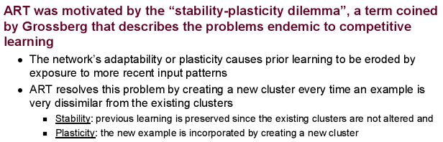
ART2 NETWORK
“Principles of Soft Computing, 2nd Edition”
by S.N. Sivanandam & SN Deepa
Copyright © 2011 Wiley India Pvt. Ltd. All rights reserved.

Slide 38
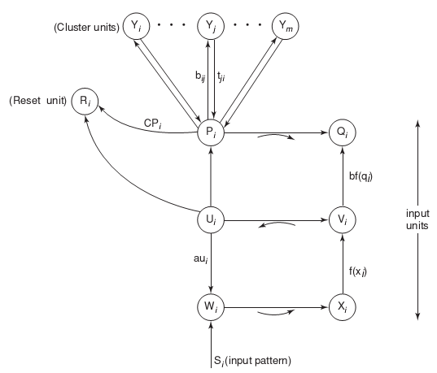
BASIC ARCHITECTURE OF ART2
“Principles of Soft Computing, 2nd Edition”
by S.N. Sivanandam & SN Deepa
Copyright © 2011 Wiley India Pvt. Ltd. All rights reserved.

Slide 39
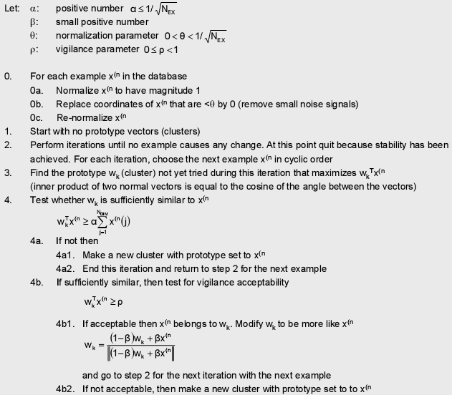
ART2 ALGORITHM
“Principles of Soft Computing, 2nd Edition”
by S.N. Sivanandam & SN Deepa
Copyright © 2011 Wiley India Pvt. Ltd. All rights reserved.

